Slide 1
Movies data
ETL Project

Slide 2
Introduction and project overview
As part of ETL project, performed the following:
Extract Movies and ratings csv data from www.Kaggle.com
Transformed the data using Python Pandas
Web scrape Amazon search for Movie Title
Performed data modeling, created a Schema and
Used SQL Alchemy to load the data SQL Lite
Query data to show results

Slide 3
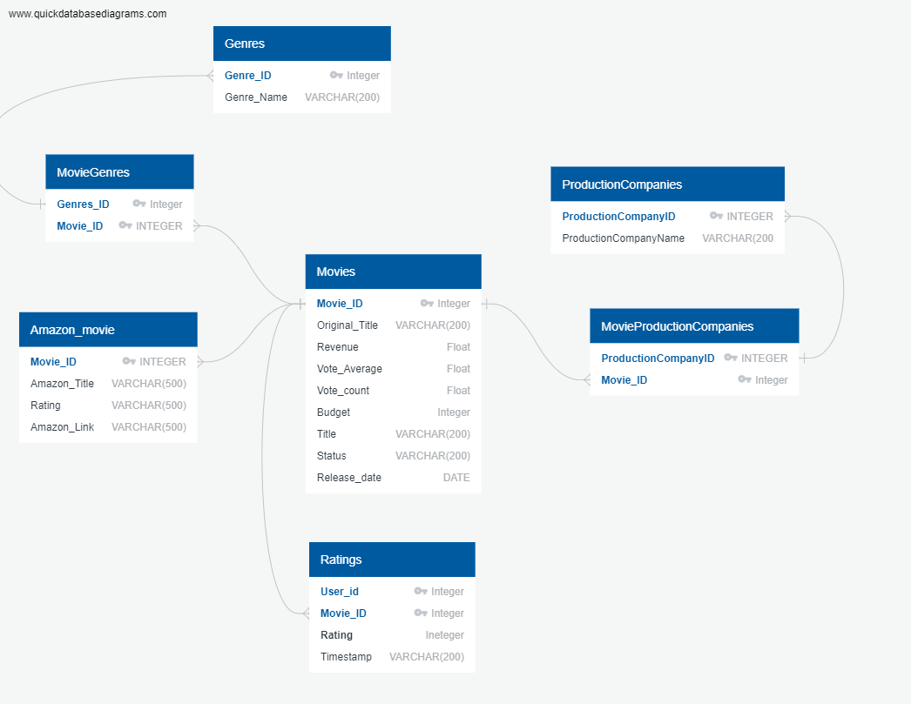
Database schema

